Slide 1

Credit Card Issuance & Risk Dashboard
Prepared by: [PADMASRI] Data Analyst Intern | June 2025

Slide 2

Objective & Dataset
Objective: Design an interactive dashboard to analyze credit card issuance and risk factors.
Dataset: cards_data.csv
Fields: Card Brand, Credit Limit, Card Type, Acct Open Date, Has Chip, Card On Dark Web

Slide 3


KPIs & Charts
KPI Cards:
• Total Cards Issued
• Cards Flagged on Dark Web
• Average Credit Limit
• Chip-Enabled Cards
• Total Unique Clients
Charts:
• Bar Chart: Top Card Brands by Issuance
• Line Chart: Monthly New Account Openings
• Pie Chart: Card Type Distribution

Slide 4
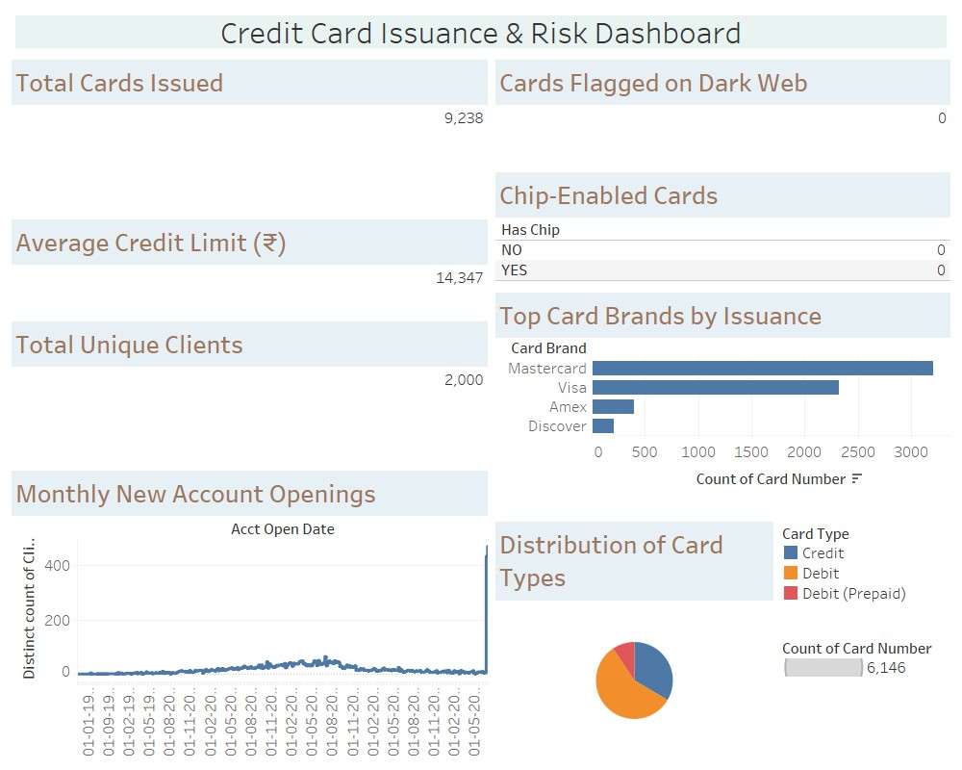
Dashboard View

Slide 5
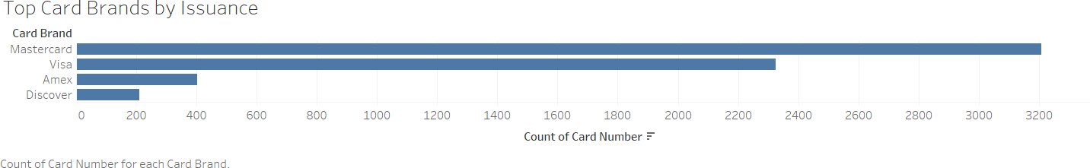
CHARTS

Slide 6
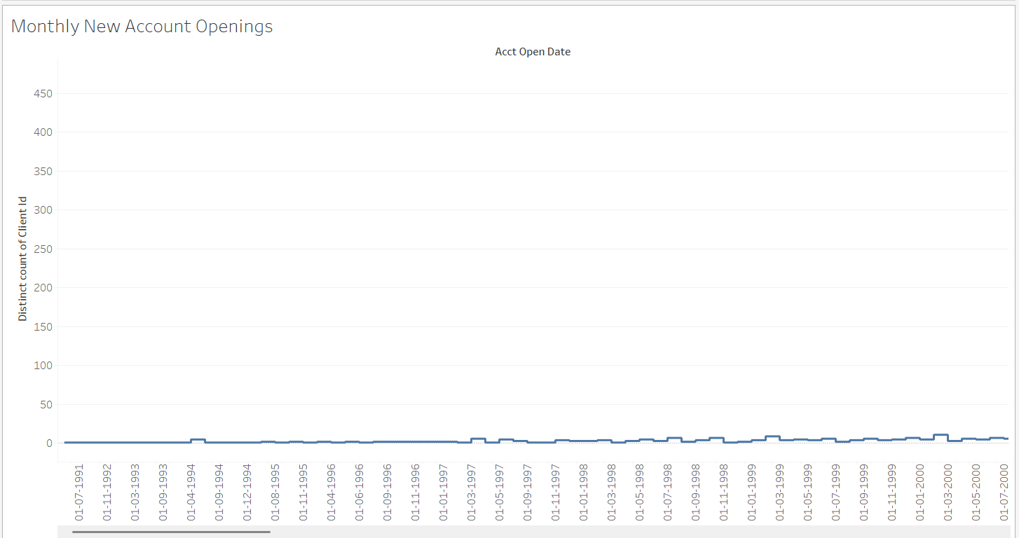
CHARTS

Slide 7
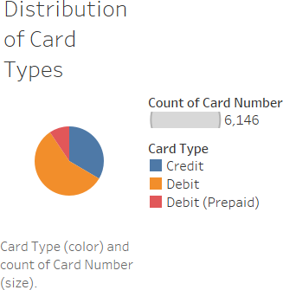
CHARTS

Slide 8

THANK YOU

